Slide 1
Africa Resilience agenda and climate change adaptation
ADMAG Nairobi
5-7 Sept
2018
Karemeri Ndungu (Kare)
Climate Change Resilience Officer, Africa
& Peter Muhangi,
Food Security and Livelihoods Advisor, Africa

Slide 2
Outline of the Presentation
IFRC & Global Policy frameworks Regional Policy Frameworks
Tools & Current situation in CCA/Resilience
Africa Resilience Framework
Partnerships
Key questions for ADMAG

Slide 3
IFRC & Global Policy frameworks
Sendai Framework
CoPs (NAPAs/NAPs, Climate Humanitarian Dialogue/Climate Action Leadership Group)
Grand Bargain (Localization of Aid)
Strategy 2020, 1BC, FCR/R2R, Africa Roadmap, Climate Change Adaptation Guidelines
Key questions for ADMAG:
How is/could NSs engage in these processes at local level?
What role could ADMAG play in support?
Notes:
UNISDR: Sendai Monitor/Community Data/
UNFCCs: CoPs (NS as part of NAPA/NAPs/NDCs)
IFRC supporting capacity of NSs to engage in NAPs (Kenya, Malawi and others as requested….gap is still there and we’d like a predictable fund to continue building that capacity) In readiness for the global funding facility for CCA/CCM of 100billion USD/year from 2020.
How to develop quality proposals through the National Designated Authorities (NDAs) to partner and acquire funding from funds like GEF, GCF

Slide 4
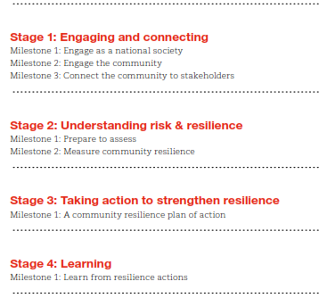
FCR/R2R Stages& Milestones
Notes:
Key points:
How can we articulate resilience in a way that is meaningful both for CBDRR practitioners and for the communities in which CBDRR
programs are implemented?
Understanding what makes a successful and sustainable CBDRR programme.

Slide 5
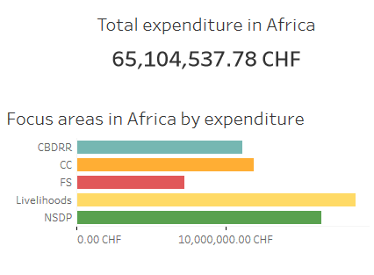
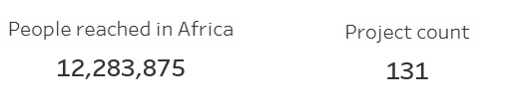
2017 Annual DRR Mapping
Notes:
Shows there is continuous increase of DRR programmes in terms of investment and the number of people reached (the data we were able to collect was not conclusive as some countries did not respond - there is a bit of decline in the 2017 figures, but otherwise the trend holds).The following are the key highlights:
In 2017 the IFRC and National Societies invested a total of 253.5 million Swiss francs on DRR projects. Most DRR investment was made in Asia Pacific (37%) and Africa (26%).
Africa Region is 2nd position in terms DRR project ‘s coverage and number of beneficiaries reached
Areas covered most in the region included: Livelihoods(28.66%); NSDP(25.10%); Climate Change(18.16%); CBDRR(17.01%); Food Security (11.04%); Globally 39% of the investment was made in CBDRR/CBDP, 25% in livelihoods, 21% in NSDP and the rest in other areas.
We continued on the same level of cost-efficiency, with an average per-capita investment of CHF 5.3.
Main donor National Societies include the American RC, Belgian RC, British RC, Danish RC, Finnish RC, French RC, German RC, Spanish RC, Swedish RC and Swiss RC.
Two National Societies in the region with high in-country DRR expenditures are Kenya RC and Sudanese RC

Slide 6
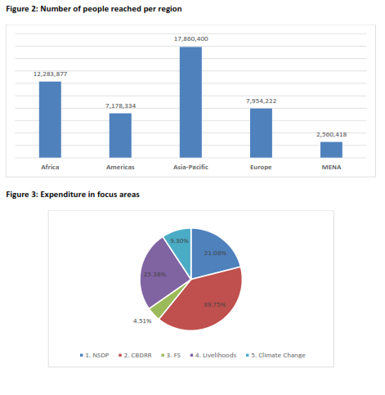
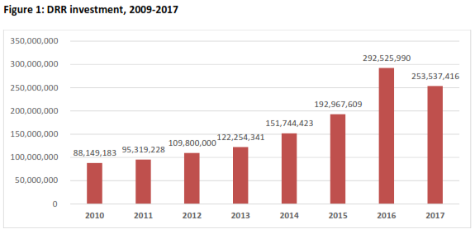
2017 Annual DRR Mapping
Notes:
Shows there is continuous increase of DRR programmes in terms of investment and the number of people reached (the data we were able to collect was not conclusive as some countries did not respond - there is a bit of decline in the 2017 figures, but otherwise the trend holds).The following are the key highlights:
In 2017 the IFRC and National Societies invested a total of 253.5 million Swiss francs on DRR projects. Most DRR investment was made in Asia Pacific (37%) and Africa (26%).
Africa Region is 2nd position in terms DRR project ‘s coverage and number of beneficiaries reached
Areas covered most in the region included: Livelihoods(28.66%); NSDP(25.10%); Climate Change(18.16%); CBDRR(17.01%); Food Security (11.04%); Globally 39% of the investment was made in CBDRR/CBDP, 25% in livelihoods, 21% in NSDP and the rest in other areas.
We continued on the same level of cost-efficiency, with an average per-capita investment of CHF 5.3.
Main donor National Societies include the American RC, Belgian RC, British RC, Danish RC, Finnish RC, French RC, German RC, Spanish RC, Swedish RC and Swiss RC.
Two National Societies in the region with high in-country DRR expenditures are Kenya RC and Sudanese RC

Slide 7
What we are doing/Could do: the how. Tools & Projects
Operationalizing our frameworks at cluster level. FCR and R2R, SARF (thru RIASCO), Gov’ts: IGAD (ICPAC [COFs]/IDDRSI), Sahel+,
Projects: LCBI, Senegal River Basin Initiative, ZRBI, GFCS, PfR
Tools: R2R (operationalizes the FCR), FbF in 12 countries, Insurance (appeals and community index-based insurance)
SLGs/ADMAGs showing Common characteristics defining community resilience
Notes:
Southern Africa Resilience Framework including partnership with RIASCO
East Africa Resilience Framework and partnership with East Africa Community
Burundi RC is currently the national co-chair of the DRR sub-committee
SLG on LCBI
FbF Pilots Ethiopia, Kenya, Madagascar, Malawi, Mali, Mozambique, Niger, Sudan, Togo, Uganda, Zambia, Zimbabwe)

Slide 8
Draft Africa Resilience Framework (Goal & Expected Results)
Goal: Targeted communities have increased resilience, stronger capacity, and reduced exposure to risks
Expected Results:
Improved NS capacity for effective implementation of resilience programmes
Improved NS organizational preparedness capacity
Increased adaptive capacity of communities (ref. CCA)
Increased ability of NSs and communities to address and reduce risk
Increased knowledge and skills of communities (vulnerability & capacity assessment, risk monitoring, risk reduction planning)

Slide 9
Draft Africa Resilience Framework (proposed IFRC roles)
Bring together RCRC Movement partners to define collective outcomes and targets for resilience programming
Identify comparative advantage of movement partners and develop a support matrix for resilience programmes
Conduct mapping & analysis of movement partners understanding of risks, needs, gaps and capacities – then identify priorities for collective action
Facilitate joint planning for movement partners
Facilitate effective coordination , Shared leadership and capacity development

Slide 10
Draft Africa Resilience Framework (proposed implementation approaches))
Application of integrated participatory community – based tools (CBDRR, EWEA, Surveillance, CBHFA etc)
Integrated programming (move away from single sector programming)
Promote RCRC Branches as Centers for building community resilience
Coordination, collaboration and advocacy (engage different stakeholders at all levels)
Bridging relief, recovery and community resilience interventions
Sequencing, layering & integration for collective impact (movement partners working together in better ways)
Linking with 1 Billion Coalition (partnerships with UN, civil society organisations, private sector, local organisations, academia)

Slide 11
Partnerships…& Advocacy
Talking with UNISDR for NSs to contribute to the Sendai Monitor of Sendai Framework
Gov’ts, DRM/DRR Laws and Policies - NAPAs/NAPs, Climate Humanitarian Dialogue/Climate Action Leadership Group)
1BC with: UN agencies (WFP/UNICEF have signed partnership agreements on 1BC); Private entities (insurance in Kenya, M-urgency for ‘uber-like’ ambulances in Nigeria)
With governments as implementing agencies for GCF/GEF applications
Key questions for ADMAG:
How is/could NSs engage in these processes at local level?
What role could ADMAG play in support?
Notes:
UNISDR: Sendai Monitor/Community Data/
UNFCCs: CoPs (NS as part of NAPA/NAPs/NDCs)
IFRC supporting capacity of NSs to engage in NAPs (Kenya, Malawi and others as requested….gap is still there and we’d like a predictable fund to continue building that capacity) In readiness for the global funding facility for CCA/CCM of 100billion USD/year from 2020.
How to develop quality proposals through the National Designated Authorities (NDAs) to partner and acquire funding from funds like GEF, GCF

